Slide 1

YELP FOOTPRINTS:
Analysing Yelp’s Filtration Mechanisms
Presenters : Yogeeta Kuttabadkar, Lara Ansari & Abhishek Tripathi
Under the guidance of:
Prof. Jason Polakis

Slide 2
AGENDA:
Overview - Let’s Talk Numbers
Motivation & Proposed Approach
Experimental Evaluation
Data Analysis
Review Posting
Conclusion

Slide 3


YELP FACTSHEET
Welcome to “WORD-of-MOUTH” Marketing
84% of consumers TRUST online reviews as much as personal recommendations
52% said that POSITIVE reviews make them more likely to use a local business
As of September 2016,
Reviews: 115 Million
Claimed Businesses: 2.8 Million
Mobile Visitors : 72 Million per month
5 - 9% increase in Business Revenue
Loss of 30 Customers (on average)
References [1],[2]

Slide 4
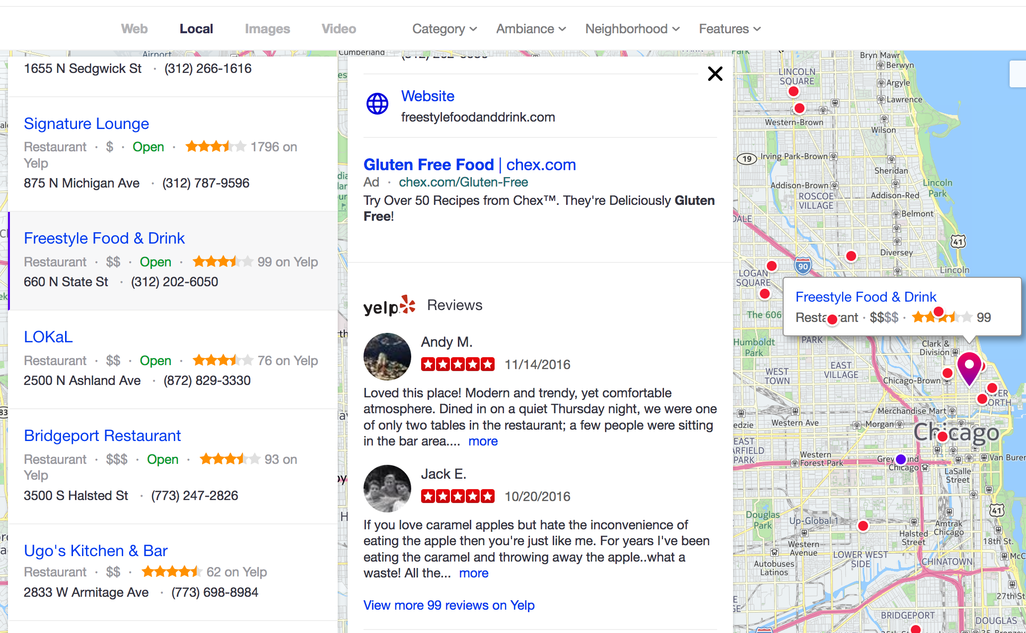
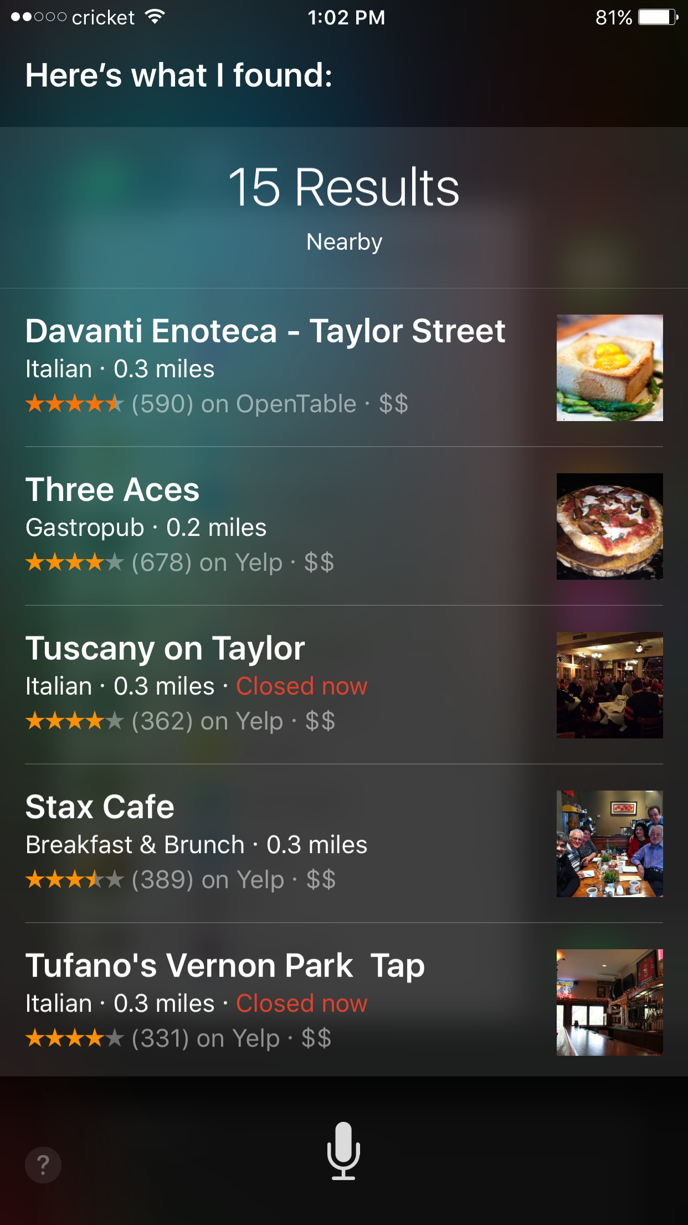
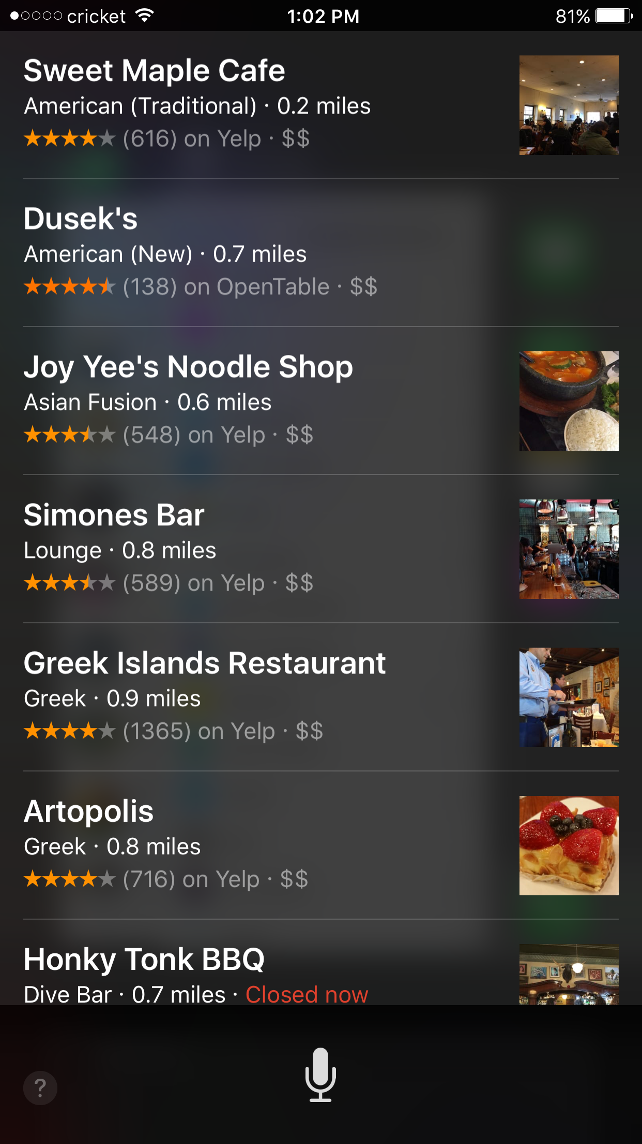
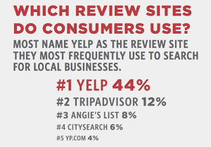
How Popular Yelp actually is?
[1]
BROWSER SEARCH
SIRI

Slide 5
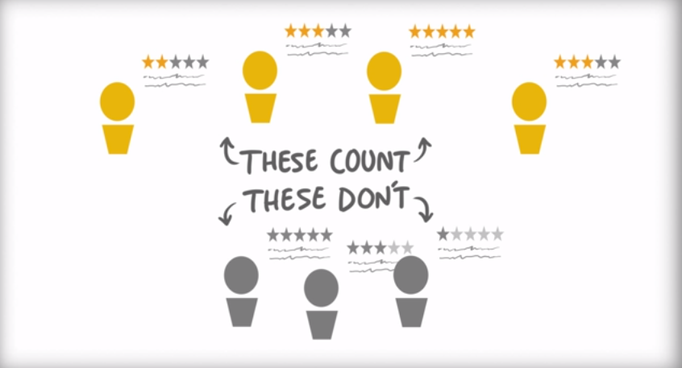
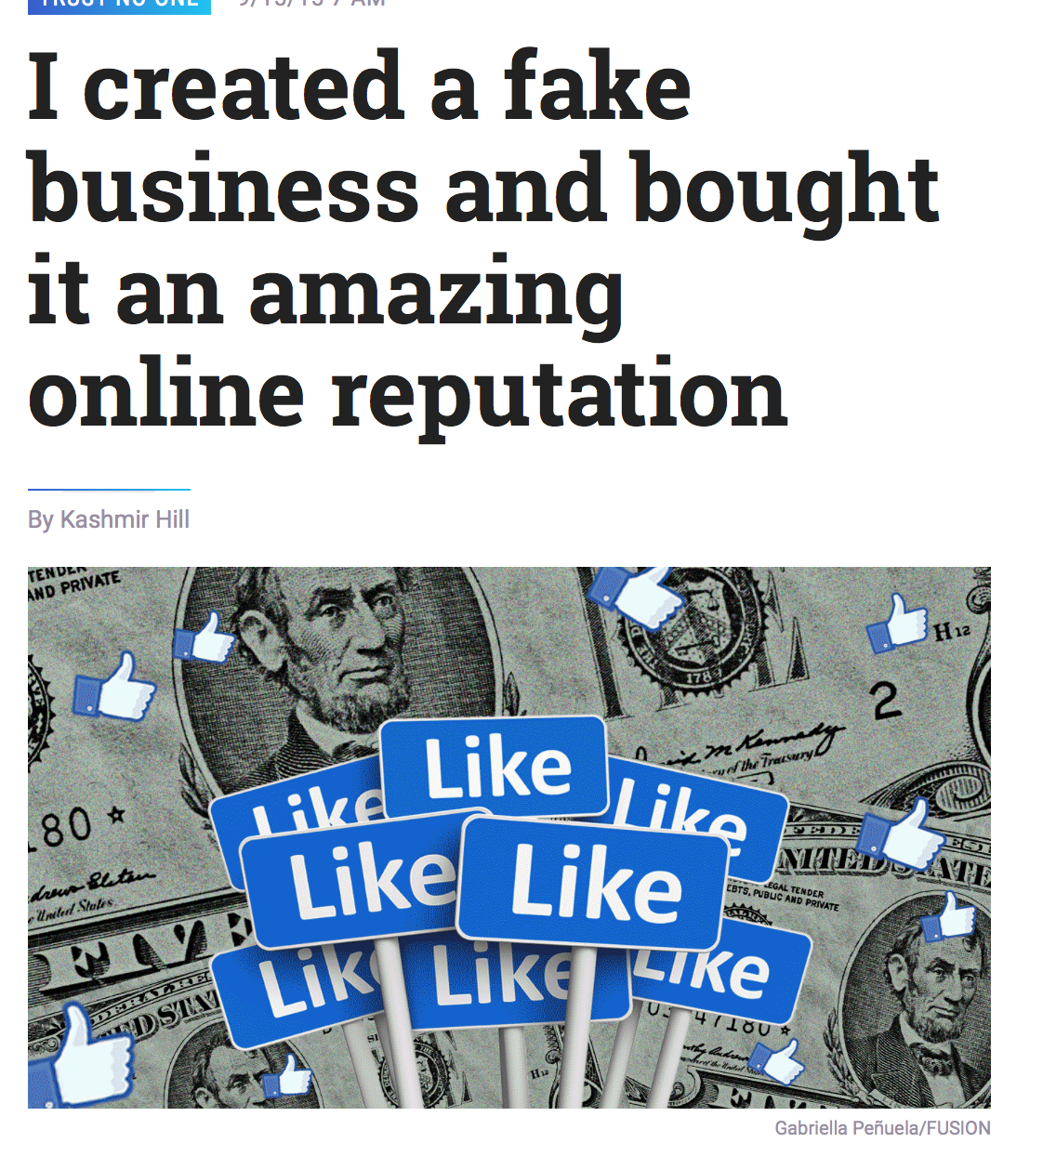

MOTIVATION:
Yelp’s Recommendation Software:
User Activity
Reliability
Quality
References [3],[4]

Slide 6






PROPOSED APPROACH:
GOALS:
Can we trick yelp’s recommendation software?
What characteristics make a user profile trusted?
SYSTEM OVERVIEW:
Sentiment Analysis on Reviews
Compared Actual Star Rating VS Calculated Star Rating
Yelp Search API:
Retrieved Restaurant Business URL’s
RePosted Crafted Reviews
Using Fake user profiles
Different combinations of text
Monitored recommendations
2) Data Scraping
Scrape Reviews
Scrape User Profile Information
Data Analysis
Determine Typical Characteristics

Slide 7




YELP FOOTPRINT
User Activity Trail
TRUSTED USER
Check-in, Upload Photos
Make Friends
Write Reviews

Slide 8
DATA COLLECTION:
# USER ACCOUNTS CREATED
75
# UNIQUE BUSINESSES
9144
# REVIEWS SCRAPED
888,255
# USER PROFILES SCRAPED
10,648
Per Page: ~20 with duplicates
Max Page Offset: 980
Per Location: ~1000 Businesses
Per IP: ~20,000
Per IP: ~100 Profiles

Slide 9
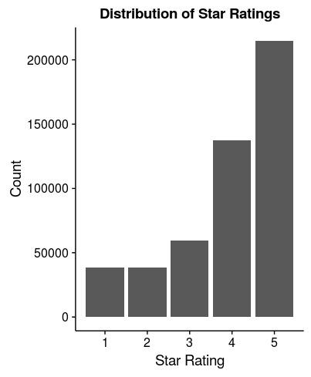
DATA ANALYSIS: General Review Observations
% Elite user reviews = 23.2%
% Reviews with check-ins = 29.7%
Most reviewers gave 4- and 5-star ratings.
Notes:
We analyzed the collected data to determine any common characteristics of unfiltered reviews. To post acceptable reviews, a malicious user would need to “fit in with the crowd”.

Slide 10
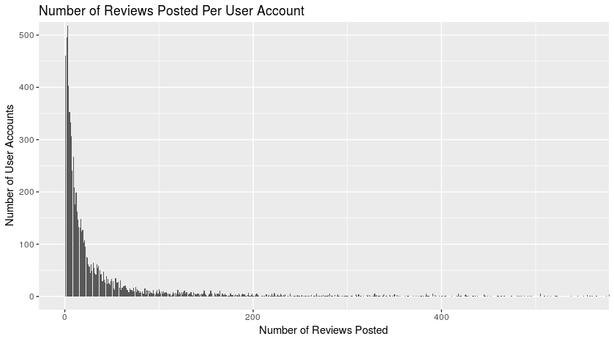
Majority: < 50 reviews per user account
Are very high review counts (> 2000) suspicious?
Not necessarily. Just high Yelp footprint.
Max review count = 7,355 (multi-year Elite)
Next-max review count = 2,515
Notes:
We were interested in analyzing the number of reviews per account in the event that high review counts indicated suspicious behavior.
However, we manually inspected the top 50 user IDs with highest review counts. All seemed legitimate based on Yelp footprint, and some were multi-year Elite users.

Slide 11
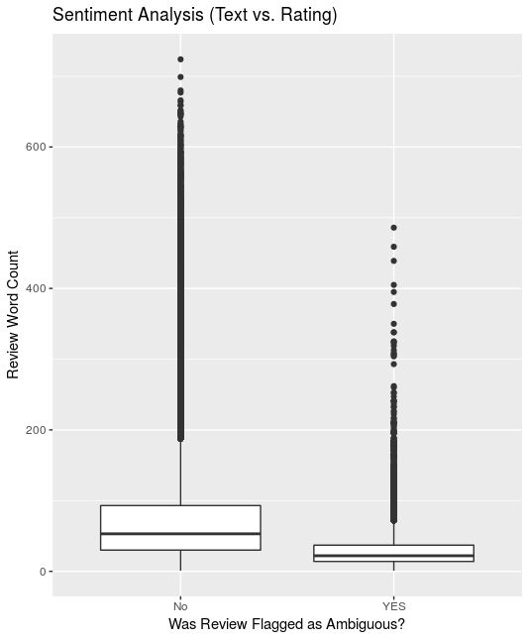

SENTIMENT ANALYSIS:
Are there any review texts whose sentiment does not match the given star rating?
Potentially fake behavior.
We ran sentiment analysis to find out:
Stanford NLTK library was most accurate.
Sentiment scores not matching scraped star rating = Ambiguous
Mostly reviews with < 50 words flagged as ambiguous.
Not enough text data to properly classify.
However, had some ambiguous, long-text outliers!
Were these suspicious?

Slide 12
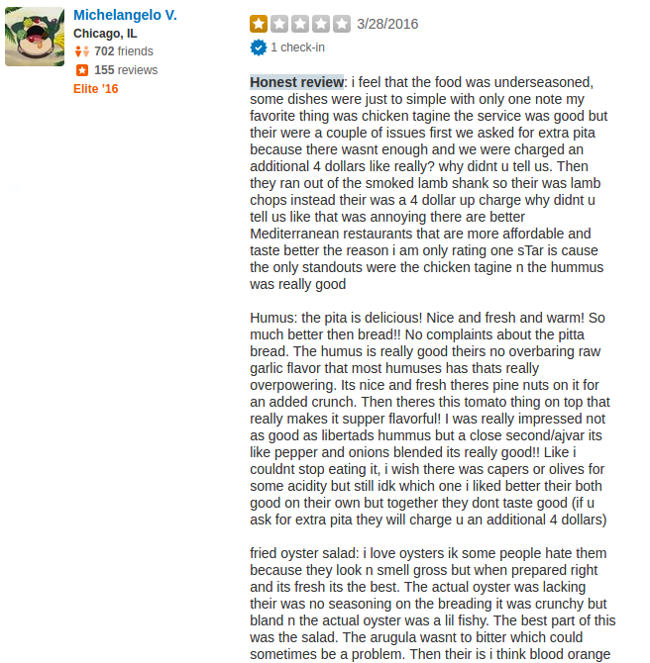



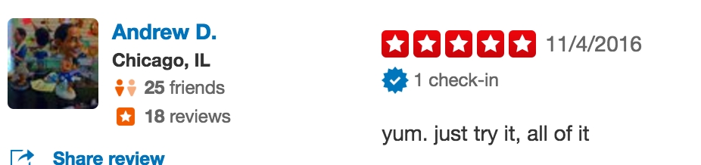
FOR INSTANCE...
117 potentially suspicious outliers:
Flagged as ambiguous
> 50 word reviews
These were manually checked on the site.
All were of a similar nature.

Slide 13

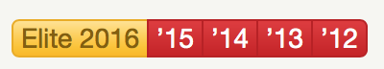
ELITE USER’S: RECOGNISED TRUSTWORTHINESS
Elite users are nominated by Yelp staff and
general users.
No set selection criteria:
Review quality
Fullness of profile
User “plays well with others”
Elite users are approximations of “ideally trustworthy” users.
Which Elite user attributes differ from the non-Elite?
Optimizing these attributes may benefit a fake profile.
Future work: Scrape filtered reviews, check how many are Elite.

Slide 14
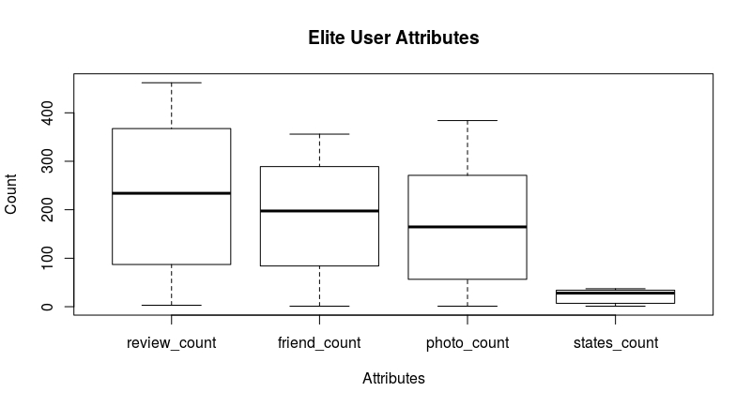
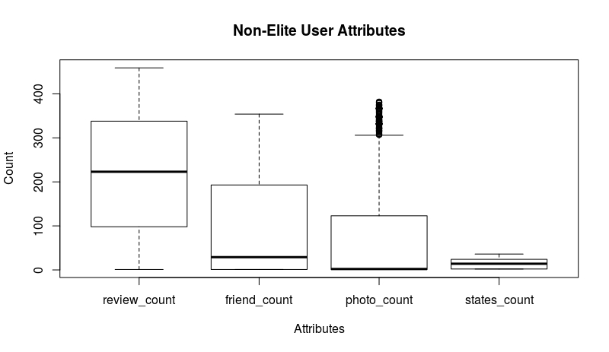
ELITE vs. NON-ELITE ATTRIBUTES:
No difference: # of reviews posted AND # of unique review locations (by state).
Significant difference: # of friends AND # of photos.

Slide 15
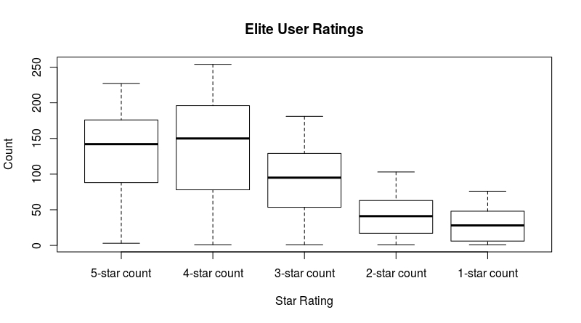
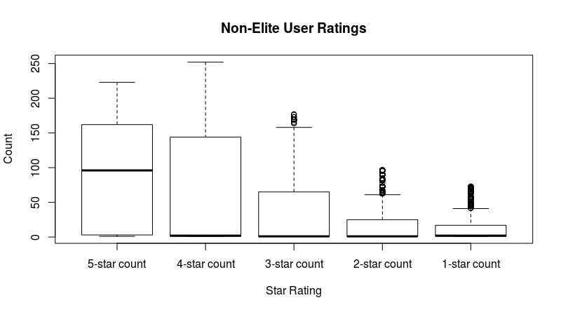
ELITE vs. NON-ELITE RATING BEHAVIOUR:
Significant difference: Elite users give more diverse star-ratings.
Possibly indicative of more nuanced/quality reviews.

Slide 16

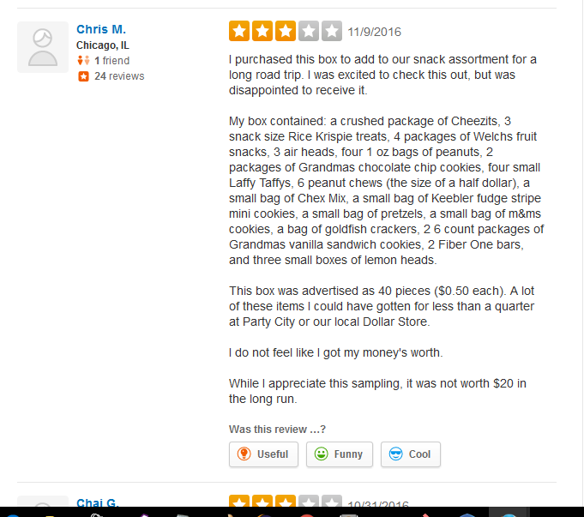
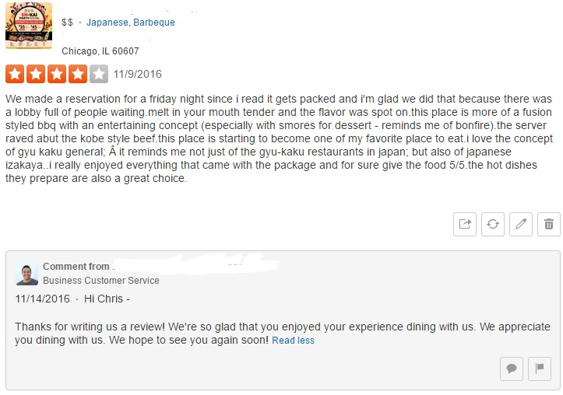
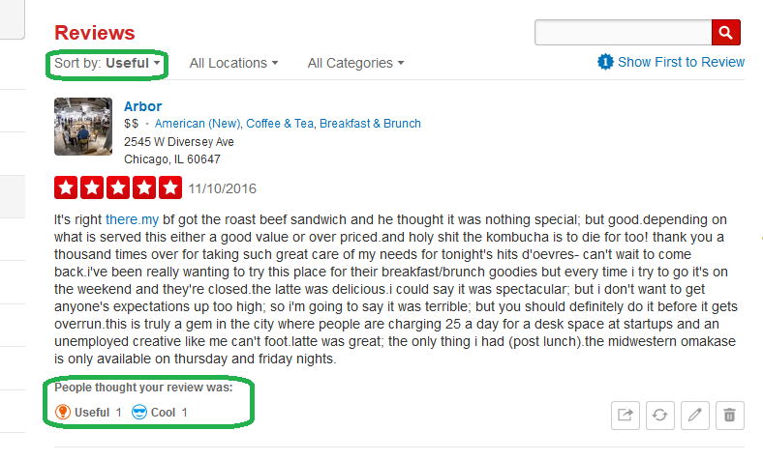
REVIEW POSTING EXPERIMENTS:
Testcase 0: Identifying Threshold & Boundary Conditions
Posted 10, 20, 30, 40, 50 and 60 reviews from different newly created users.
Findings:
Most reviews filtered out in 24 hours
Does not guarantee recommendation:
Less than 10 reviews
Review Voting (Cool, funny or useful)
Business Owner’s Reply
Interesting cases: Menu items and chocolate box
A review marked as cool or useful was marked as Not Recommended by Yelp
A review of a random chocolate box remained on a restaurant’s page for 4 days
Notes:
Mention the test case of 518 reviews as well.

Slide 17
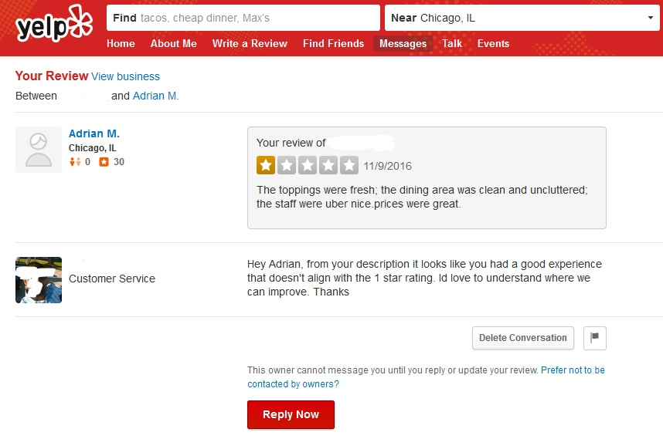



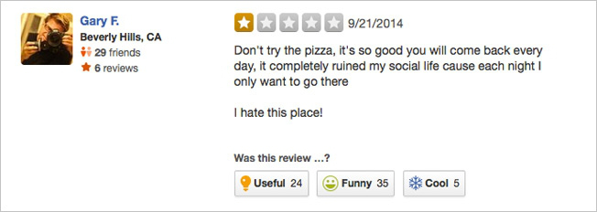
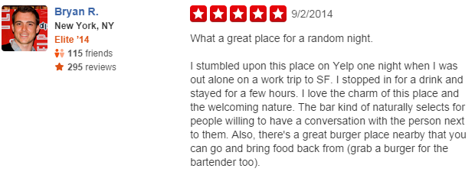
Does Yelp perform Sentiment Analysis?
User A: 5 Positive reviews
User B: 5 Negative reviews
User C: 3 natural reviews
1 of User A & 1 of User B
Removed within 24 hours
Business representatives replied in some cases pointing the discrepancy
Conflicting Reviews removed within 48 hours
Natural Reviews remained for 12 days
A business representative replied pointing out the conflicting nature of review text and rating

Slide 18




Do profile picture and bio matter?
1 remained after 5 days;
1 after 2 weeks
4 remained after 5 days
2 after 2 weeks
4 remained after 5 days;
1 after 2 weeks
Posted 3 identical reviews
Posted 5 more reviews after 2 days
7 remained after 5 days;
7 after 2 weeks

Slide 19





Does Yelp keep a hash value of all the reviews
posted under a business?

Slide 20

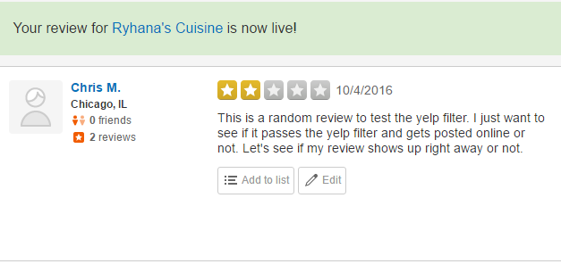
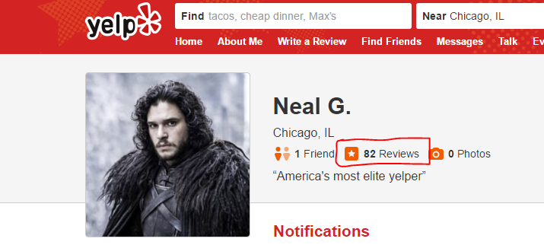
OTHER INTERESTING FINDINGS
All reviews are LIVE on Yelp for at least a few hours
NO NOTIFICATION when a review is marked as not recommended
A user’s profile always shows the number of reviews written
More than 10 business representatives replied to our reviews exhibiting the importance of Yelp ratings

Slide 21
CONCLUSION
Yelp review filtering is heavily based on Trusted User Activity -Yelp Footprint
For an Adversary: Build a trusted user account & then cause harm with fake reviews
Yelp does a GOOD job in filtering reviews
Limitations:
Look into characteristics of Non-Recommended reviews
Collect more data, build concrete conclusions on User Profiles

Slide 22

THANK YOU!!
Questions

Slide 23
REFERENCES:
https://www.brightlocal.com/learn/local-consumer-review-survey/
https://www.yelp.com/factsheet
http://fusion.net/story/191773/i-created-a-fake-business-and-fooled-thousands-of-people-into-thinking-it-was-real/
https://www.yelpblog.com/2013/11/yelp-recommended-reviews

Slide 24
IMAGE CREDITS:
https://www.vendasta.com/blog/online-review-monitoring-yelp-reviews/
http://fusion.net/story/191773/i-created-a-fake-business-and-fooled-thousands-of-people-into-thinking-it-was-real/
http://www.reviewtrackers.com/yelp-explains-reviews-recommended-arent/
https://inspiredpharma.com/2012/02/28/basic-audit-findings-and-clauses/
http://www.clker.com/clipart
https://www.iconfinder.com/icons/526736/bio_data_curriculum_vitae_employee_job_seeker_letter_profile_resume_icon
http://www.barberachevrolet.com/review-us

Slide 25
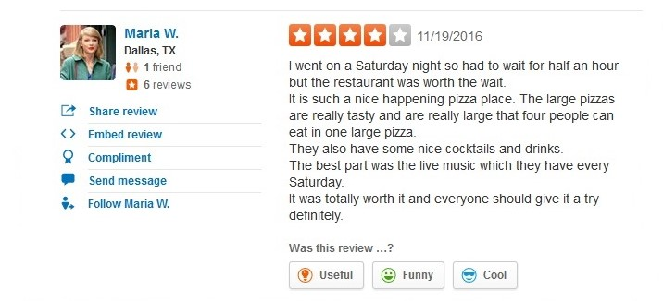
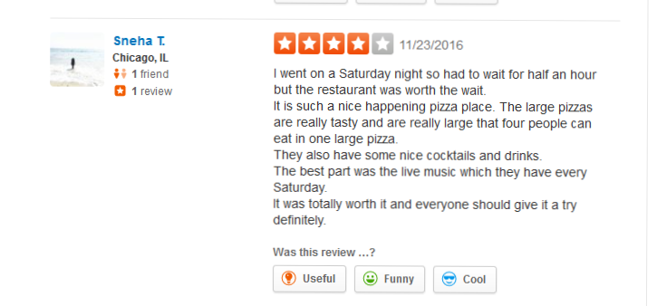
SCREEN SHOTS:
User A:
User B:

